Slide 1
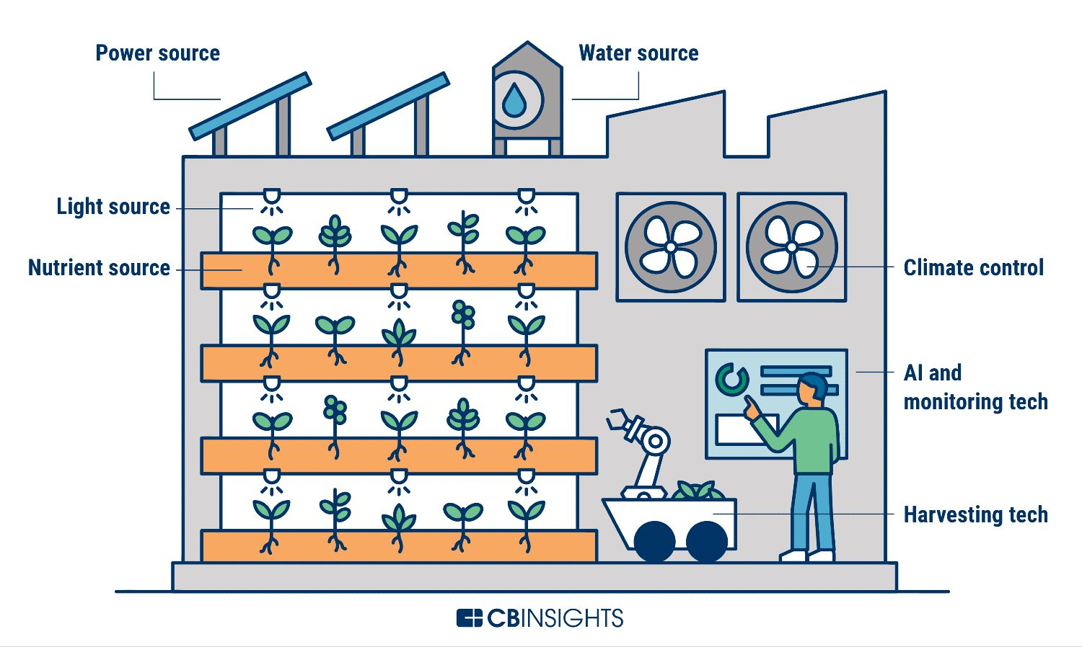
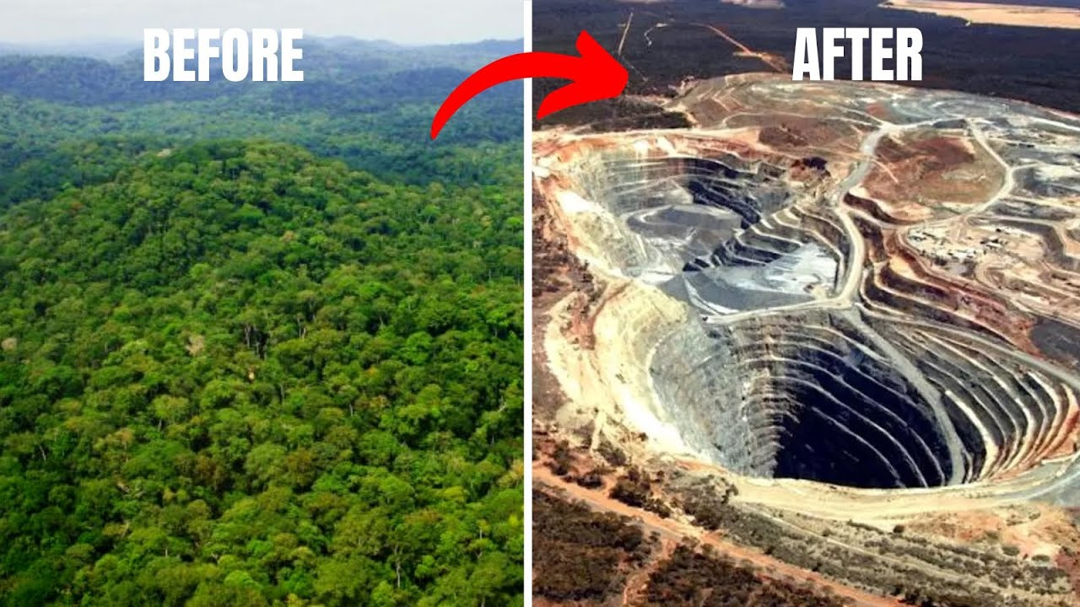
The Fight for Bio-Fuel
Why Bio-Fuel?
Bio-Fuel relates to liquid fuel created from bio-mass, such as plants, algae, and animal waste
Two Main Types: Ethanol (ethyl alcohol) and Bio-Diesel
High demand for eco-friendly alternatives to oil
Avoid destroying land and water sources through lithium mining and increased oil drilling
Solution
Incentivize companies to increase Ethanol and Bio-Diesel production
Increase production for renewable resources, such as increased farming
Create vertical farms with their purpose of creating bio-mass for increased Bio-Fuel production
Impact – Benefits and Reasons
Lower CO2 levels through cleaner burning fuel source
Increase oxygen output from large amount of plants year round
Conserve natural land from the destruction of mining and increased drilling
Bio-Fuel is seen as “carbon-neutral” due to the amount of CO2 pulled from the air by vegetation before the vegetation is used to create a fuel source
Farmers will reap benefits from increased profits due to higher demand of bio-mass to create Bio-Fuel
Implementation of Bio-Fuel
Build vertical farms to increase growing capabilities to meet new demand
Build more refineries to refine the bio-mass into usable fuel
Increase distribution across the nation
Require car manufacturers to make newly built vehicles compatible with ethanol blended fuel (many diesel vehicles are already capable of running on Bio-Diesel due to their compression-based ignition)

Slide 2
Resources
“Biofuel Basics | Department of Energy.” Office of Energy Efficiency & Renewable Energy, www.energy.gov/eere/bioenergy/biofuel-basics. Accessed 9 Oct. 2024.
Lithium Mine Comparison. https://i.ytimg.com/vi/aODw_5jyDmc/maxresdefault.jpg. Accessed 12 Oct. 2024.
Selin, Noelle Eckley, and Clarence Lehman. “Biofuel.” Encyclopædia Britannica, Encyclopædia Britannica, inc., 6 Sept. 2024, britannica.com/technology/biofuel.
Vertical Farm Components. 17 Apr. 2024. SmartTek, https://smarttek.solutions/blog/vertical-farming/. Accessed 12 Oct. 2024.

